Slide 1


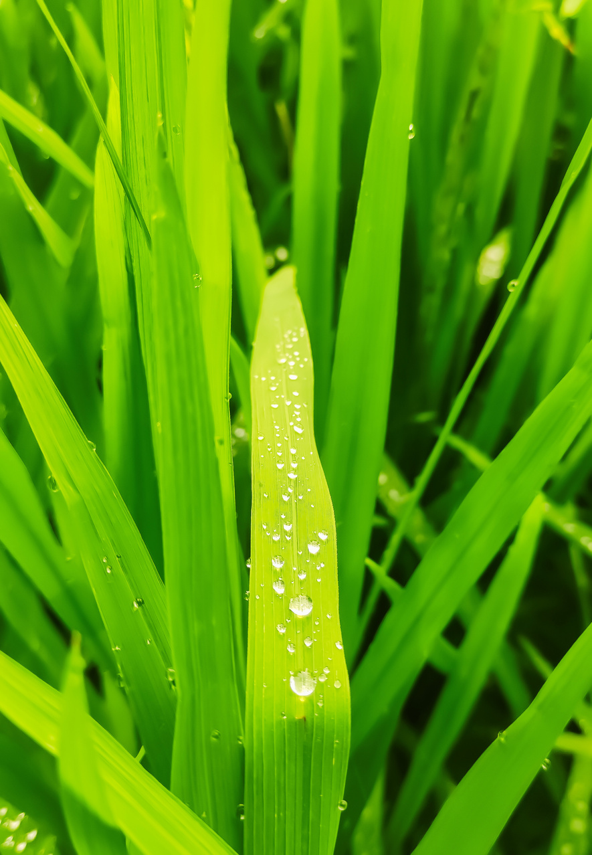


Sentinel Harvest Watcher
Anshul Anilkumar Mundakatil
017416334
San Jose State University
Final Project Report
ISE 244: AI Tools and System Engineering

Slide 2

Rice, a crucial agricultural crop, often suffers from diseases, leading to decreased yields and crop failure, impacting food security and economics. Image recognition, especially through Computer Vision and AI, plays a critical role in efficiently identifying rice diseases, aiding in their management and promoting sustainable agriculture.

Slide 3
Literature Review
Number of Diseases | Type of Disease | Methods | Highest Accuracy (%)
1 | Bakanae disease | SVM, GA | 87.90
10 | Rice diseases including rice blast, rice false, smut, rice brown spot, etc. | Novel CNN with 7 layers | 95.48
9 | Rice diseases including false smut, brown plant hopper, etc. | Simple CNN | 93.30
1 | Rice blast | CNN. SVM, LBPH | 95.83
4 | Rice diseases include rice blast, bacterial blight, and sheath rot, brown spot | DNN_JOA, ANN, DAE | 97.00
1 | Rice blast | RiceTalk | 89.40
1 | Different levels of contamination of grain discoloration | InceptionV3 | 88.20
3 | Rice blast. bacterial leaf blight, sheath blight | AlexNet CNN + SVM | 91.37

Slide 4


Technologies and Tools Utilized
Languages: Python, Javascript, Java
Software Platforms: Jupyter Notebooks, Anaconda, Android Studio.
Web Platforms used: Kaggle, Google Colab

Slide 5
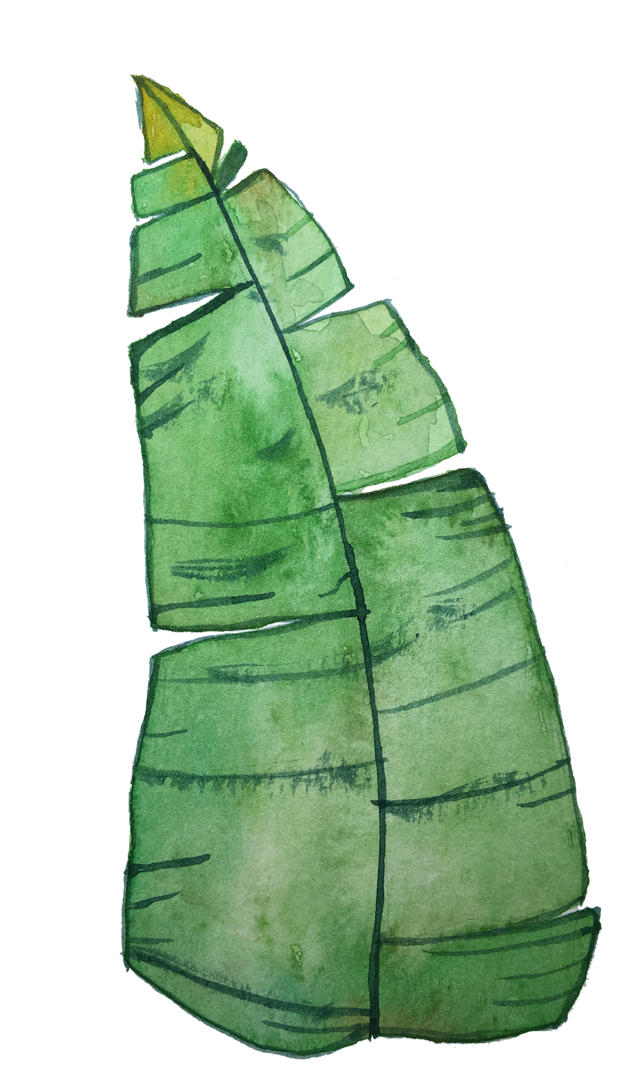
Project Objective
The project addresses challenges in rice disease detection, particularly the complexity of backgrounds in farm settings. While Convolutional Neural Networks (CNNs) provide excellent results, they tend to underperform when trained on images with complex backgrounds. To overcome this, the project proposes a novel approach, PSO-CNN (Particle Swarm Optimization Convolution Neural Network), which uses Particle Swarm Optimization to find the best hyperparameters for CNNs, enhancing their performance in complex backgrounds.
The project aims to develop a mobile-based application using TensorFlow Lite to enable on-device machine learning, allowing farmers to accurately determine crop conditions. By revolutionizing rice disease detection through AI and Computer Vision, the project contributes to sustainable agriculture and ensures food security.

Slide 6

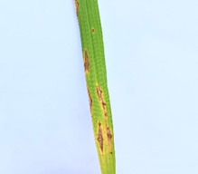
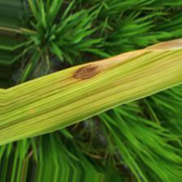
DATASET REQUIREMENTS
Sample 1 | Sample 2 (Required)

Slide 7
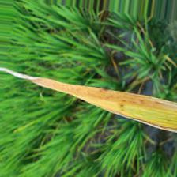
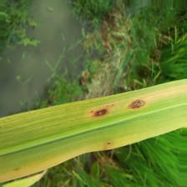
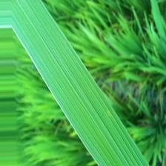

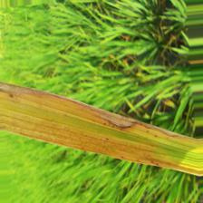
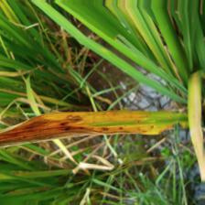
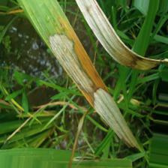
DATABASE CLASSES
Bacterial Leaf Blight
Brown Spot
Healthy Rice leaf
Leaf Blast
Leaf Scald
Sheath Blight

Slide 8
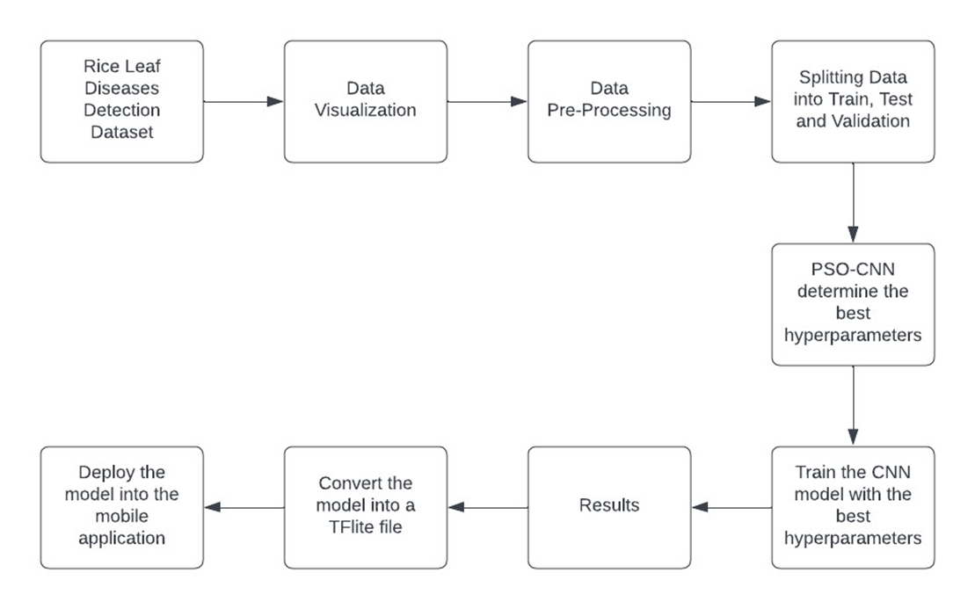
system architecture

Slide 9
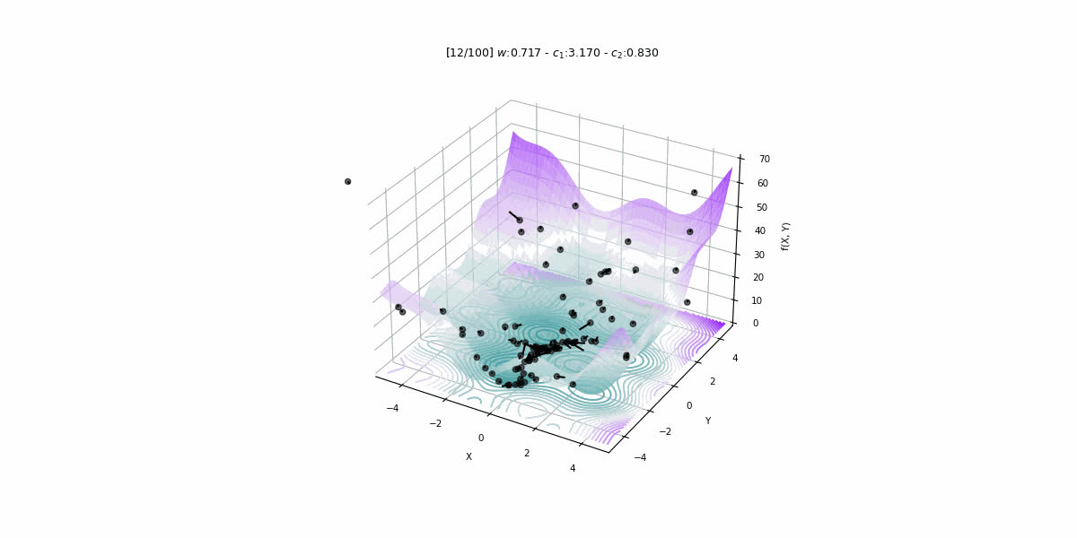
Particle Swarm Optimization

Slide 10
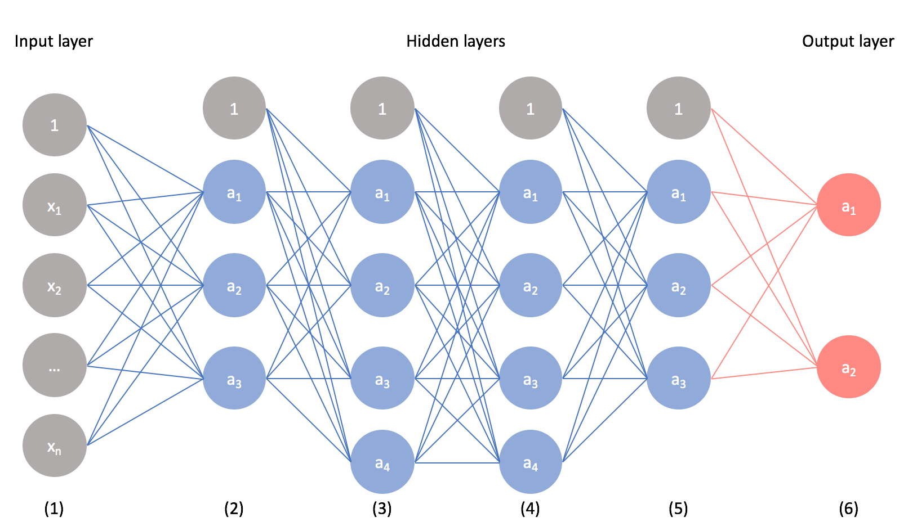
Convolutional Neural Network

Slide 11
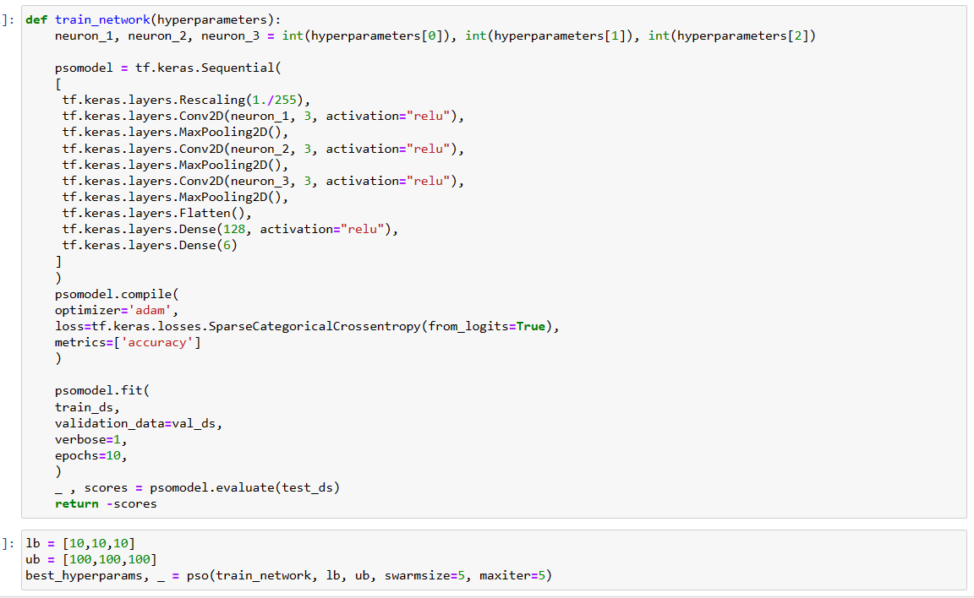
Particle Swarm Optimizer-CNN

Slide 12
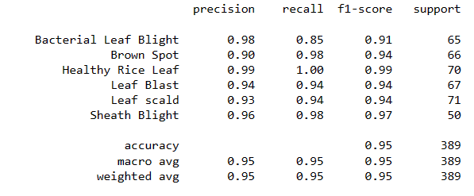
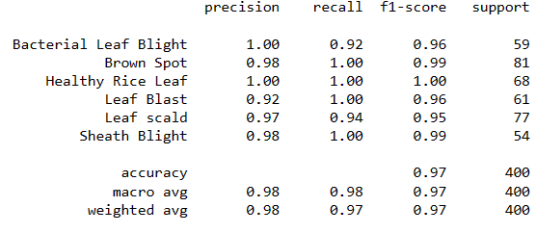
Classification Report Comparision
CNN run on random parameters for 10 epochs
CNN run on optimized parameters for 10 epochs

Slide 13
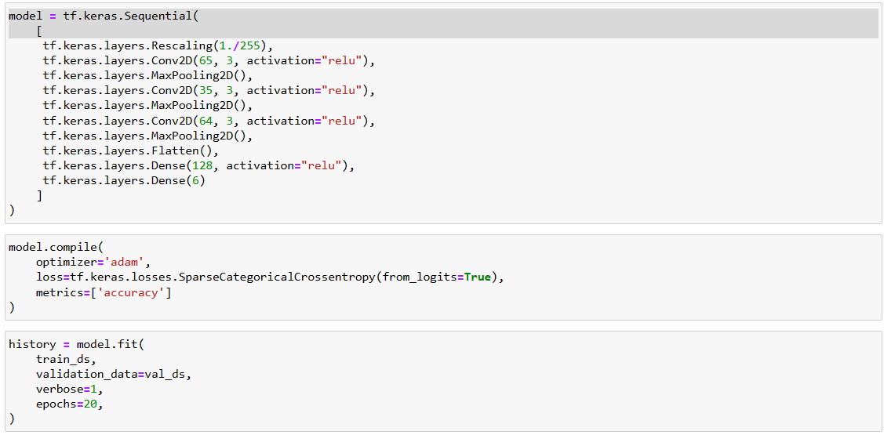
Optimized CNN

Slide 14
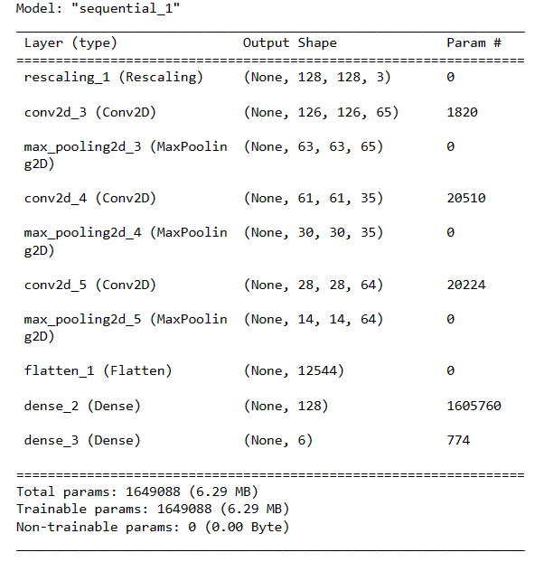
Optimized CNN

Slide 15
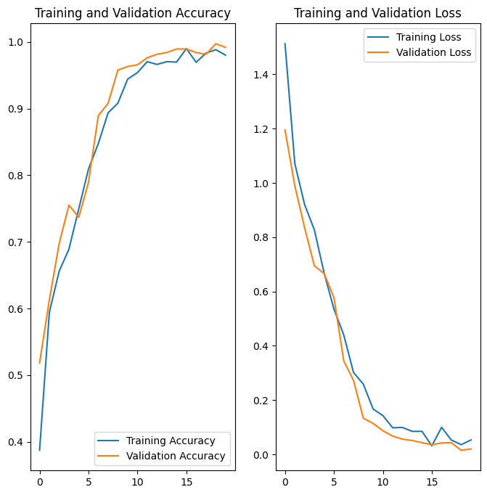
Training and Validation Loss and Accuracy

Slide 16
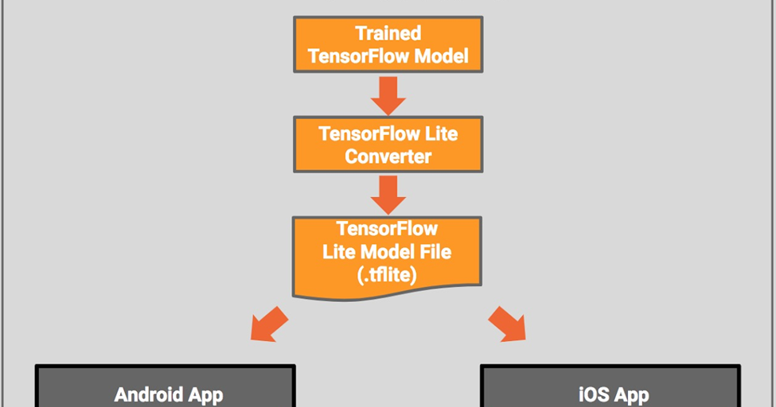
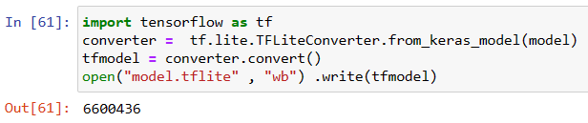
DEPLOYING TO TFLITE MODEL

Slide 17
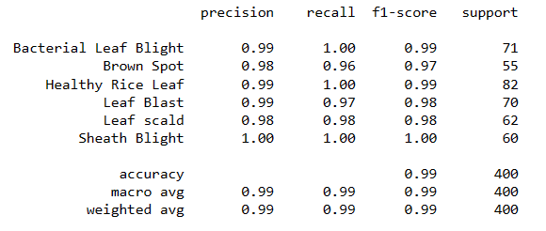
Classification Report

Slide 18
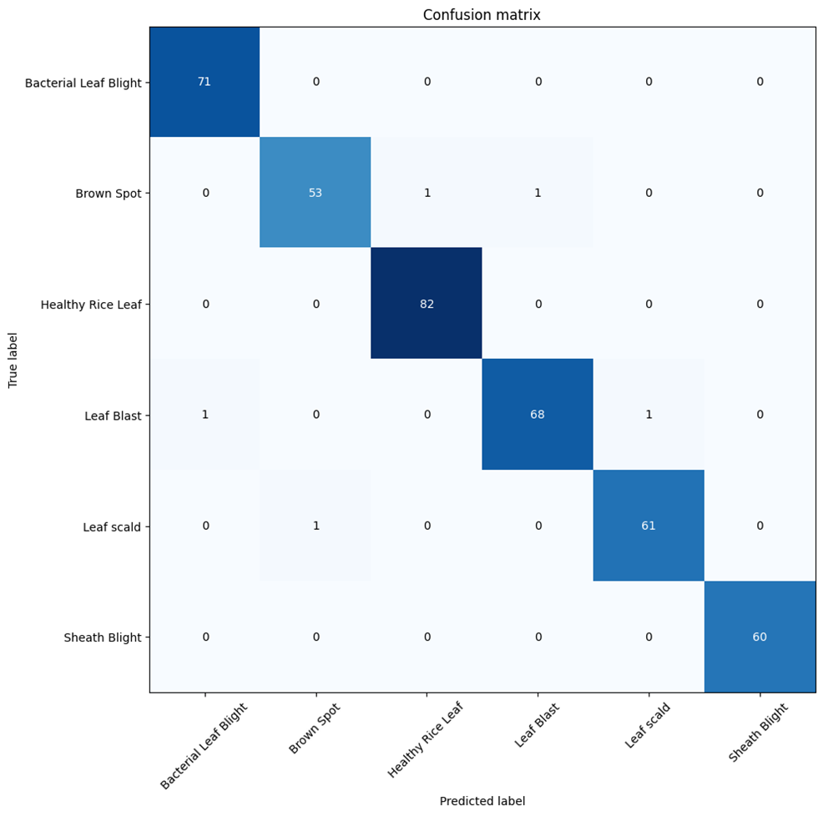
Confusion Matrix

Slide 19
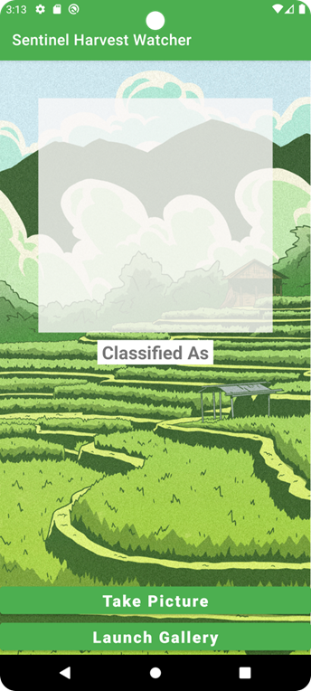
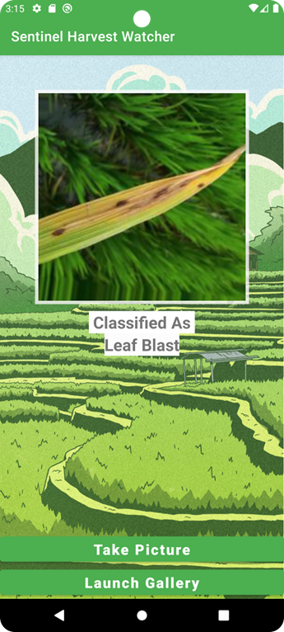
App Interface Overview

Slide 20
Future Scope
Scope expansion to include additional crops would require refining the CNN model and potentially incorporating other powerful models.
As the dataset grows, adjustments to hyperparameters such as learning rate and kernel size would be necessary, especially if using models other than CNN.
Future scope includes suggesting the type of pesticide based on the disease, which would require separate training, data, and model development but could provide an optimal solution.

Slide 21
REFERENCES
K. Ahmed, T. R. Shahidi, S. M. Irfanul Alam and S. Momen, "Rice Leaf Disease Detection Using Machine Learning Techniques," 2019 International Conference on Sustainable Technologies for Industry 4.0 (STI), Dhaka, Bangladesh, 2019, pp. 1-5, doi: 10.1109/STI47673.2019.9068096.
Wang, Y., Wang, H., & Peng, Z. (2021). Rice diseases detection and classification using attention based neural network and bayesian optimization. Expert Systems with Applications, 178, 114770.
Ahad, M. T., Li, Y., Song, B., & Bhuiyan, T. (2023). Comparison of CNN-based deep learning architectures for rice diseases classification. Artificial Intelligence in Agriculture, 9, 22-35.
Hassan, S. M., & Maji, A. K. (2022). Plant disease identification using a novel convolutional neural network. IEEE Access, 10, 5390-5401.
Chung, C. L., Huang, K. J., Chen, S. Y., Lai, M. H., Chen, Y. C., & Kuo, Y. F. (2016). Detecting Bakanae disease in rice seedlings by machine vision. Computers and electronics in agriculture, 121, 404-411.
Lu, Y., Yi, S., Zeng, N., Liu, Y., & Zhang, Y. (2017). Identification of rice diseases using deep convolutional neural networks. Neurocomputing, 267, 378-384.
Rafeed Rahman, C., Saha Arko, P., Eunus Ali, M., Khan, M. A. I., Hasan Apon, S., Nowrin, F., & Wasif, A. (2018). Identification and Recognition of Rice Diseases and Pests Using Convolutional Neural Networks. arXiv e-prints, arXiv-1812.
Liang, W. J., Zhang, H., Zhang, G. F., & Cao, H. X. (2019). Rice blast disease recognition using a deep convolutional neural network. Scientific reports, 9(1), 1-10.
Ramesh, S., & Vydeki, D. (2020). Rice disease detection and classification using deep neural network algorithm. In Micro-Electronics and Telecommunication Engineering: Proceedings of 3rd ICMETE 2019 (pp. 555-566). Springer Singapore.
Duong-Trung, N., Quach, L. D., Nguyen, M. H., & Nguyen, C. N. (2019, January). Classification of grain discoloration via transfer learning and convolutional neural networks. In Proceedings of the 3rd International Conference on Machine Learning and Soft Computing (pp. 27-32).
Shrivastava, V. K., Pradhan, M. K., Minz, S., & Thakur, M. P. (2019). Rice plant disease classification using transfer learning of deep convolution neural network. The International Archives of the Photogrammetry, Remote Sensing and Spatial Information Sciences, 42, 631-635.

Slide 22
REFERENCES
Engelbrecht, A. P. (2007). Introduction to computational intelligence. Computational Intelligence, 1-13.
Kennedy, J., & Eberhart, R. (1995, November). Particle swarm optimization. In Proceedings of ICNN'95-international conference on neural networks (Vol. 4, pp. 1942-1948). ieee.
Shi, Y., & Eberhart, R. (1998, May). A modified particle swarm optimizer. In 1998 IEEE international conference on evolutionary computation proceedings. IEEE world congress on computational intelligence (Cat. No. 98TH8360) (pp. 69-73). IEEE.
Particle swarm optimization (PSO) with constraint support — pyswarm 0.6 documentation. (n.d.). Pythonhosted.org. https://pythonhosted.org/pyswarm/
TensorFlow Lite guide. (n.d.). TensorFlow. https://www.tensorflow.org/lite/guide
Data: Rice Leaf Diseases Detection. (n.d.). Www.kaggle.com. Retrieved May 9, 2024, from https://www.kaggle.com/datasets/loki4514/rice-leaf-diseases-detection
Introduction — PySwarms 1.3.0 documentation. (n.d.). Pyswarms.readthedocs.io. Retrieved May 9, 2024, from https://pyswarms.readthedocs.io/en/latest/intro.html#it-s-all-a-treasure-hunt
tf.lite.TFLiteConverter | TensorFlow v2.16.1. (n.d.). TensorFlow. Retrieved May 9, 2024, from https://www.tensorflow.org/api_docs/python/tf/lite/TFLiteConverter
Raj, A. (2022, June 13). ML in Android -3 : Deploy Tflite on Android using Java. The STEM. https://medium.com/the-stem/ml-in-android-3-deploy-tflite-on-android-using-java-6a18431644b6
Sunil, C. K., Jaidhar, C. D., & Patil, N. (2023). Tomato plant disease classification using multilevel feature fusion with adaptive channel spatial and pixel attention mechanism. Expert Systems with Applications, 228, 120381.
Chang, B., Wang, Y., Zhao, X., Li, G., & Yuan, P. (2024). A general-purpose edge-feature guidance module to enhance vision transformers for plant disease identification. Expert Systems with Applications, 237, 121638.
Liu, Z., Zhou, G., Zhu, W., Chai, Y., Li, L., Wang, Y., ... & Sun, L. (2024). Identification of rice disease under complex background based on PSOC-DRCNet. Expert Systems with Applications, 249, 123643.

Slide 23

THANK YOU

